Slide 1
SDS et stockage Objet : La modernisation du stockage avec Red Hat Ceph Storage
05 Novembre 2020
Jérôme Brusq
Specialist Solution Architect
jbrusq@redhat.com

Slide 2

Votre équipe Red Hat
Tony Botté - Sales Account Manager
tbotte@redhat.com
06 03 85 32 94
Thibault Jurado-Leduc - Architecte Solution
tjl@redhat.com
06 07 80 77 68
Jérôme Brusq - Spécialiste Architecte Solution
jbrusq@redhat.com
06 77 34 31 81

Slide 3
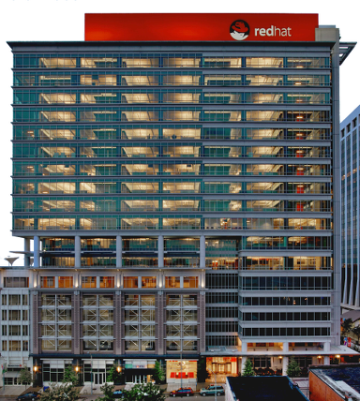

Solutions 100%
OPEN SOURCE
pour l’entreprise
Red Hat & Storage …
CA >3 Milliards $
Permabit - Acquisition
Noobaa - Acquisition
Ansible - Acquisition
3Scale - Acquisition
CA > 2 Milliards $
FeddHenry (Mobilité) - Acquisition
eNovance (OpenStack) - Acquisition
S2 : Rachat par IBM
Inktank (CEPH) - Acquisition
Red Hat OpenStack Platform
Red Hat Storage
OpenShift Enterprise
Red Hat ajouté à l’indice S&P 500
CentOS rejoint Red Hat
CA > 1 Milliard $
Red Hat Enterprise Virtualisation
Enterprise Linux - 1ère release
ManageIQ et Makara - Acquisitions
JBoss - Acquisition
Introduction en bourse
Création
1993
1999
2002
2006
2009
2011
2012
2013
2014
2015
2016
2017
2018
2019
50% des effectifs Red Hat sont des Développeurs / Ingénieurs qui contribuent au quotidien à l’animation, l’évolution des projets communautaires.
33% des effectifs français
~ 13 000
employés
95
Bureaux
dans le monde
35
pays

Slide 4










DES COMMUNAUTÉS AU PRODUIT D’ENTREPRISE
ACCÉLÉRER VOS PROJETS
RED HAT
VIRTUALIZATION
RED HAT STORAGE
IaaS
RED HAT SATELLITE
1M+
projects*
RED HAT
OPENSTACK PLATFORM
RED HAT
ENTERPRISE LINUX
RED HAT CLOUDFORMS
RED HAT JBOSS
MIDDLEWARE
PaaS
RED HAT OPENSHIFT
CONTAINER PLATFORM

Slide 5
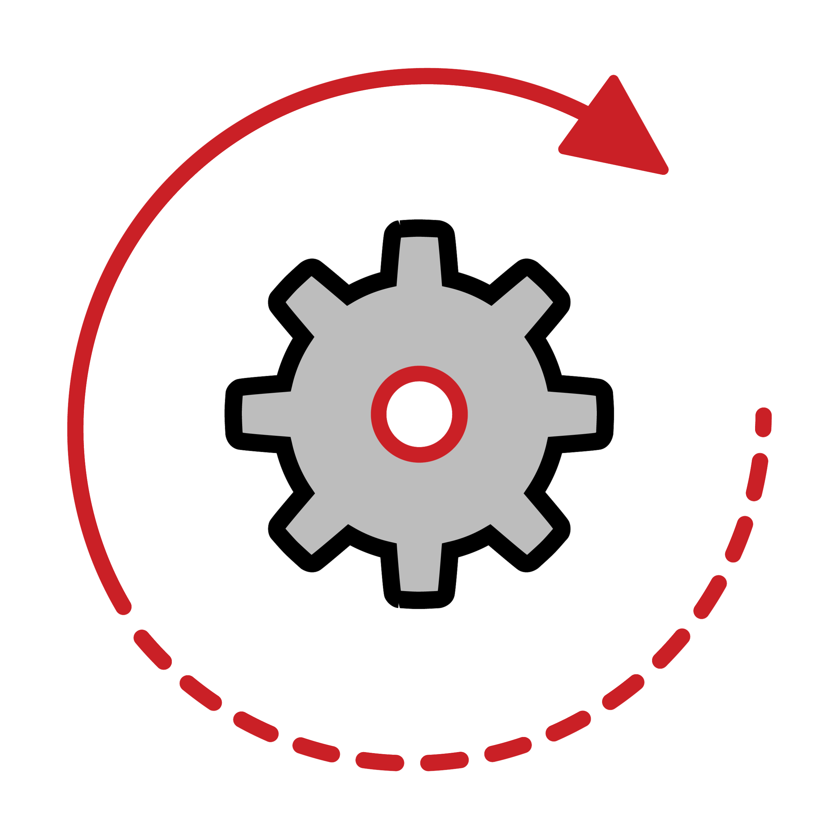
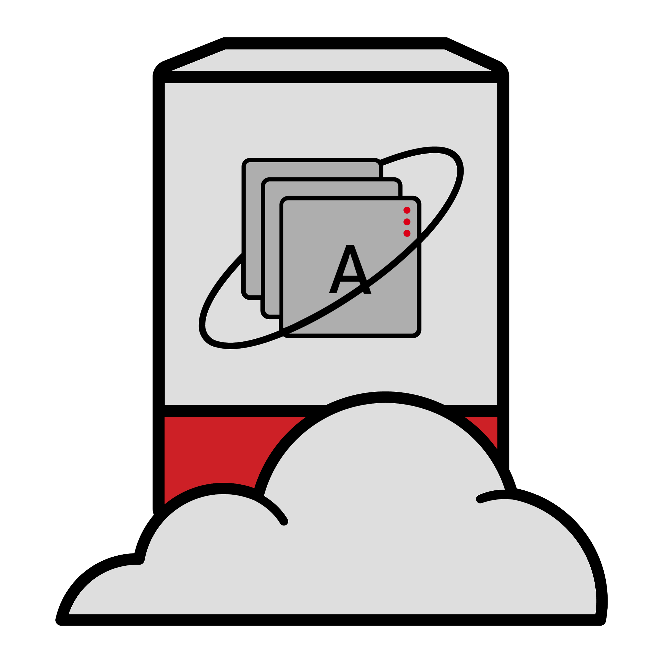








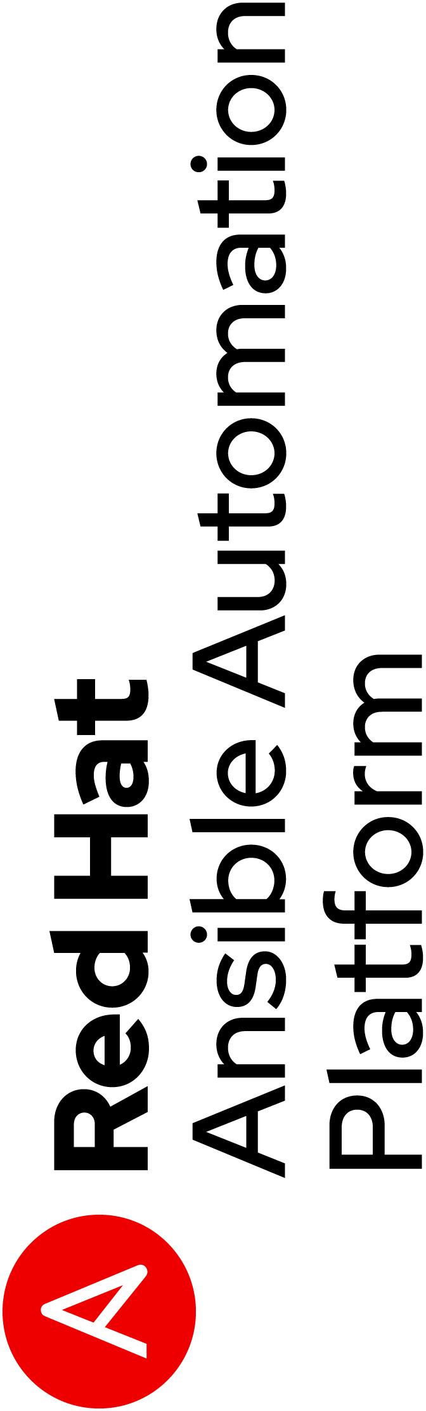
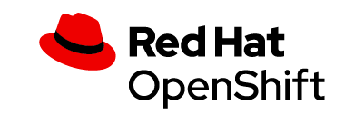















Red Hat Open Hybrid Cloud portfolio
Red Hat Advanced Cluster Management for Kubernetes
Other public clouds
Edge

Slide 6
Software Defined Storage

Slide 7
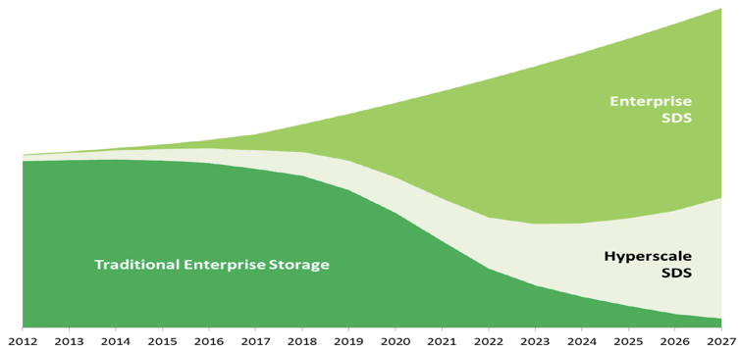
Du stockage traditionnel … au Software Defined Storage…

Slide 8
Red Hat Ceph Storage
SDS Benefits
PROPRIETARY
HARDWARE
Common,
off-the-shelf hardware
Lower cost, standardized supply chain
SCALE-UP
ARCHITECTURE
Scale-out
architecture
Increased operational flexibility
HARDWARE-BASED
INTELLIGENCE
Software-based
intelligence
More programmability, agility,
and control
CLOSED DEVELOPMENT
PROCESS
Open development
process
More flexible, well-integrated
technology

Slide 9
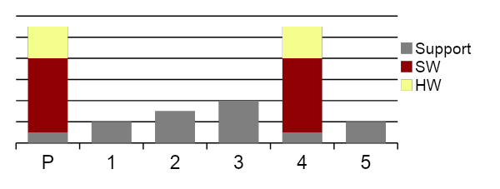
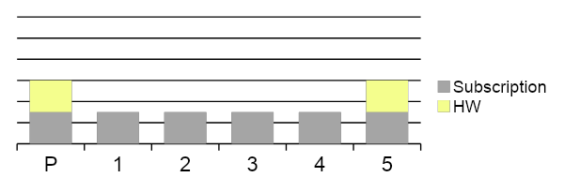
SDS Benefits
APPLIANCE-BASED STORAGE
SOFTWARE-DEFINED STORAGE
Migration
Migration
Appliance
Purchase Appliance every 3-5 years
  Proprietary HW + SW
  Software is basically repurchased with refresh
Appreciating Support YoY
  To incent HW+SW refresh
Proprietary HW
Decoupled SW & HW
  Software Transfer
  Single Subscription
Consistent Subscription payments
  Year 1 = Year 3 = Year 5
Best of Breed HW
  Purchase HW only as needed
SDS gives huge savings (50%+) in TCO due to no migration, no HW lock-in and less admin

Slide 10
Red Hat Ceph Storage

Slide 11


Red Hat Ceph Storage
Distributed, enterprise-grade object storage, proven at web scale
Open source, massively-scalable, software-defined based on Ceph
Flexible, scale-out architecture on clustered standard hardware
Single, efficient, unified storage platform (object, block, file)
Designed for modern workloads

Slide 12

CEPH COMMUNITY
Vibrant developer community
Multi vendor collaboration
298 contributors
495,431 lines of code changed
From multiple countries
  USA, China, Germany, India
198 organizations
  ≅70% of code from Red Hat
Variety of vendors
  Intel, Samsung, Alibaba, Tencent, Mirantis...
Broad solution Ecosystem
Proven Production deployments
Vendor published solutions across diverse workloads
  Intel
  Samsung
  Sandisk
Multi petabyte production deployments of Ceph
  Tencent (Object)
  Salesforce (Object)
  CERN
  …

Slide 13
RHCS architecture

Slide 14
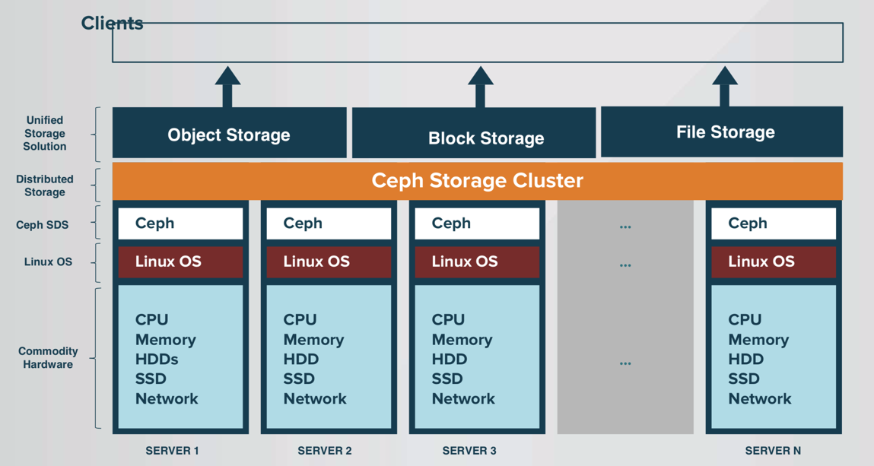
Ceph Architecture Overview

Slide 15
Ceph Architecture Components
OBJECT
BLOCK
FILE
RGW
S3 and Swift
object storage
RBD
Virtual block device
CEPHFS
Distributed network
file system
LIBRADOS
Low-level storage API
RADOS
Reliable, elastic, distributed storage layer with
replication and erasure coding

Slide 16
RHCS Design : Examples
IOPS-optimized
solutions:
Throughput-optimized
Solutions:
Cost and
capacity-optimized
solutions:
CPU: 10 cores per NVMe SSD, assuming a 2 GHz CPU.
RAM: 16 GB baseline, plus 5 GB per OSD.
Networking: 10 Gigabit Ethernet (GbE) per 12 OSDs (each for client- and cluster-facing networks).
Disks : High-performance, high-endurance enterprise NVMe SSDs.
CPU: 0.5 cores per HDD, assuming a 2 GHz CPU.
RAM: 16 GB baseline, plus 5 GB per OSD.
Networking: 10 GbE per 12 OSDs each for client- and cluster-facing networks.
Disks
Datas : 7,200 RPM enterprise HDDs.
Metadatas : High-endurance, high-performance enterprise serial-attached SCSI (SAS) or NVMe SSDs.
CPU: 0.5 cores per HDD, assuming a 2 GHz CPU.
RAM: 16 GB baseline, plus 5 GB per OSD.
Networking: 10 GbE per 12 OSDs (each for client- and cluster-facing networks).
Disks : 7,200 RPM enterprise HDDs.

Slide 17
Use case #1 : Object storage

Slide 18


Object storage … the standard S3
Amazon S3 (Amazon Simple Storage Service) : Object storage of AWS, launched in 2006
The basic storage units of Amazon S3 are objects which are organized into buckets.
Each object is identified by a unique, user-assigned key
Good fit for non-structured data
HTTP (PUT/GET/DELETE)
Endpoint
AccessKey/SecretKey
Bucket
Aws region

Slide 19



S3 clients
s3cmd
Cyberduck
Cyberduck

Slide 20
Object storage benefits
Scalabilité infinie : espace de nom « plat »
Simple d'accès via une API REST,
Ajouts de metadata sur les objets,
Accès distribué pour les clients,
Davantage de sécurité (multi-factor authentication, encryption, gestion des droits plus fine, etc.)
De nouvelles fonctionnalités (versioning des objets, notifications, cycle de vie de la donnée, etc.)
Efficacité (Erasure Coding) et performance (MultiPart Upload)

Slide 21


Object Storage
BACKUPS
ACTIVE ARCHIVES
DATA LAKES

Slide 22
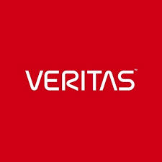
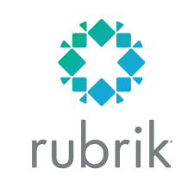
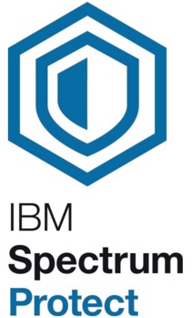
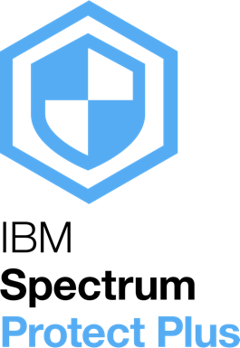
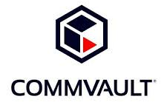


Object storage: Data backup infrastructure

Slide 23

Object storage as a service
Capable of handling audio, visual and any other documentation
RGW, Ceph’s object
storage interface
User
User
NFS gateway for bulk import and export of object data
Ceph object gateway
Ceph object gateway
Multi-site active-active clusters w/ single namespace
Storage cluster
US-East
Storage cluster
US-West

Slide 24




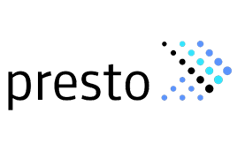



Object storage—Red Hat data analytics infrastructure
Bare-metal RHEL
Cluster 1
Hadoop Cluster 2
Worker
Hadoop Cluster 3
Worker
Worker
Compute
Worker
Worker
Compute
Worker
Compute
Worker
Compute
Worker
Storage
Compute
Compute
Storage
Worker
Compute
Storage
Compute
Storage
S3A
S3A
S3A/S3
Storage
Compute
Storage
Storage
Storage
Storage

Slide 25
RGW Features
Very strong S3 API compatibility
  https://github.com/ceph/s3-tests functional test suite
Security (AD/Ldap)
Encryption (various flavors of API like Vault)
Compression
Metadata search with ElasticSearch
Bucket notifications
Multiple storage classes
  Map classes to RADOS pools
  Choose storage for individual objects or set a bucket policy
Lifecycle management
  Bucket policy to automatically move objects between storage tiers and/or expire
  Time-based
Archive zone
  Archive and preserve full storage history

Slide 26
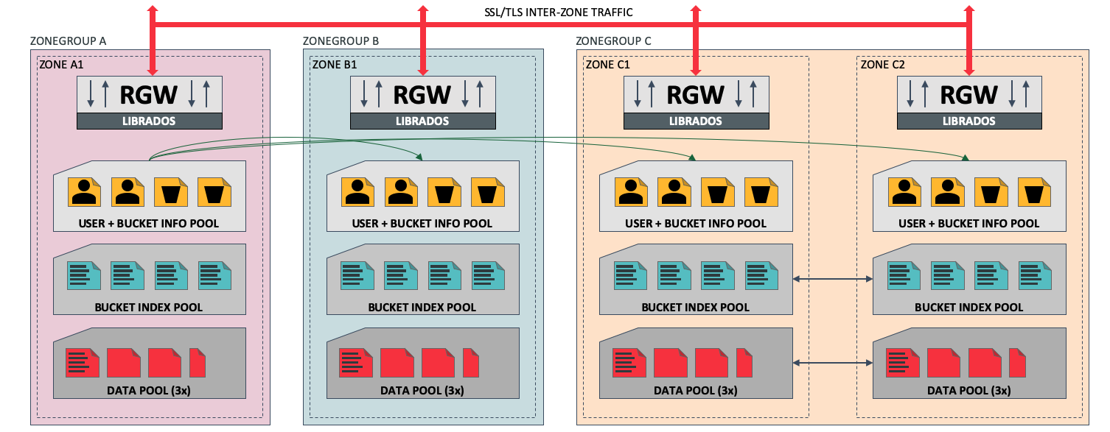
S3 Federation et Multi Sites
Zones may be different clusters and/or sites
Global view of users and buckets
Each bucket placed in a ZoneGroup
Data replicated between all Zones in a ZoneGroup

Slide 27


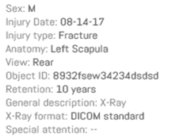
Object storage : Example
Stockage Fichier
Stockage objet

Slide 28








Example : Bucket notifications
HTTP API
Message content (very) simplified:
The object <object name> has been Created/Deleted at HH:mm:ss in the bucket <bucket name>.
Kafka Topic
Object
Bucket
AMQP

Slide 29
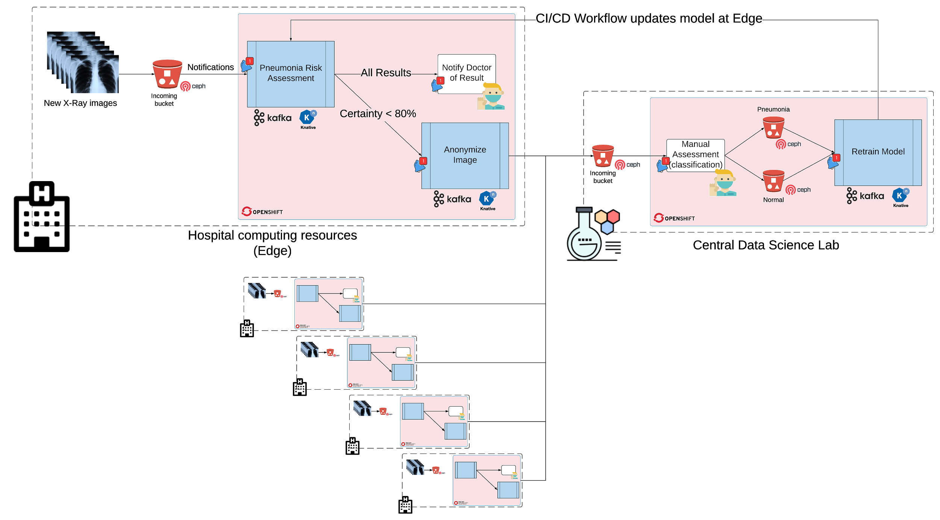
Example : Automated data Pipeline
https://medium.com/analytics-vidhya/automated-data-pipeline-using-ceph-notifications-and-kserving-5e1e9b996661

Slide 30
Use case #2 : Storage for Openstack

Slide 31
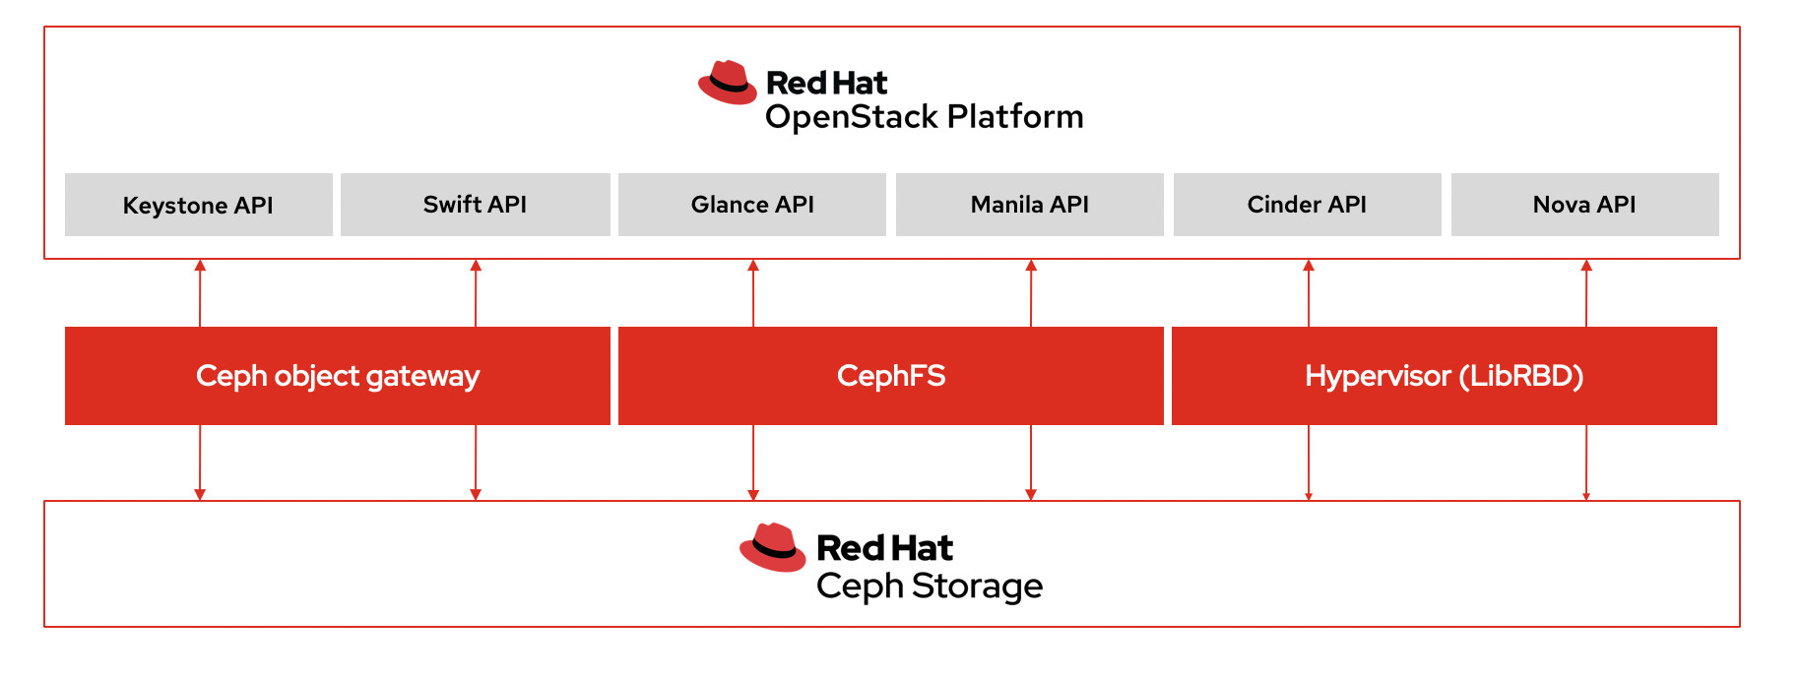
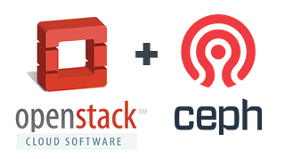
Complete and unified storage for OpenStack
100% integrated
Modular end transparent integration for ephemeral and persistent storage needs:
  Nova, Cinder, Manila, Glance, Keystone, Swift
Performant – VM start and snapshots optimized

Slide 32
Use case #3 : Storage for Openshift

Slide 33




Openshift Container Storage (OCS)
OpenShift uses an OCS addon to provide storage
Notes:
How External Mode is realized
External Mode is realized by placing the actual storage disk resources outside the OCP worker- of Infra nodes by using a Red Hat Ceph Storage (RHCS) cluster instead, although still being operated by OCS operators. These operators run on the OCP cluster and don’t require a 3 node setup like OCS in Internal mode does. Only 4 CPU units are required on the OCP side.
Multiple OCP clusters can use the same RHCS cluster for External mode.
Each individual OCP cluster will require an OCS-Plugin. This plugin will come with a fixed price per OCP cluster.

Slide 34






OCS : Multi Cloud Gateway (Noobaa)
App
Multi-Cloud Buckets
App
S3 API
Hybrid Buckets
App
Multi-site Buckets
App
Notes:
This slide shows functionality the MCG basically delivers.
Offering ONE Single Storage Fabric - exposed to apps by a scalable S3 Object Interface (API)
The backend can exist of literally all kind of storage resources, both on-prem or cloud/hybrid-cloud and multi-cloud based.

Slide 35
En résumé

Slide 36

RHCS Technical Benefits
Massive scalability to support petabytes of data
Relies on no single point of failure, for maximum uptime
Self-manages and self-heals to reduce maintenance
Data distributed among servers and disks dynamically
Multi site capabilities
Block , File and Object storage
Very Strong S3 compatibility API (https://github.com/ceph/s3-tests)

Slide 37
Coupure Pub ;-)...

Slide 38
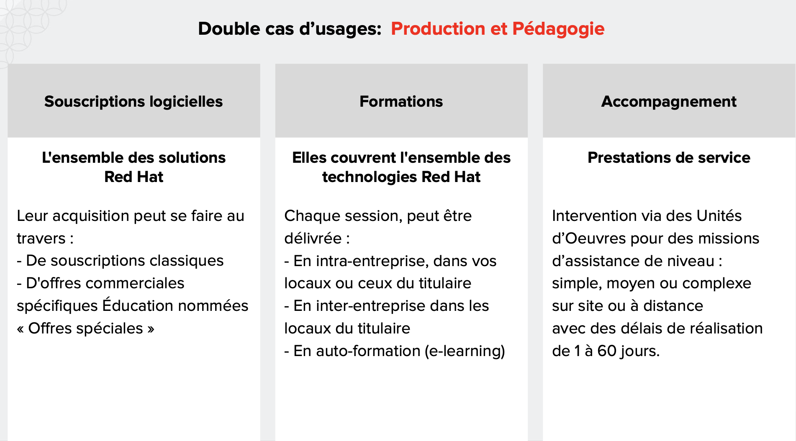
Marché MENESRI: Red Hat - Groupe Logiciel

Slide 39
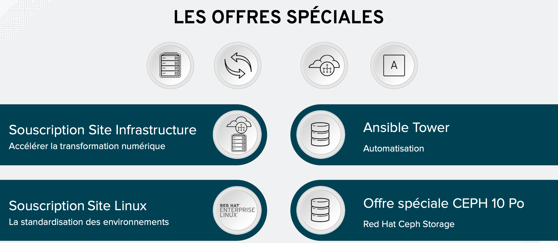
Offres spécifiques pour les Campus, Labos,...
=

Slide 40
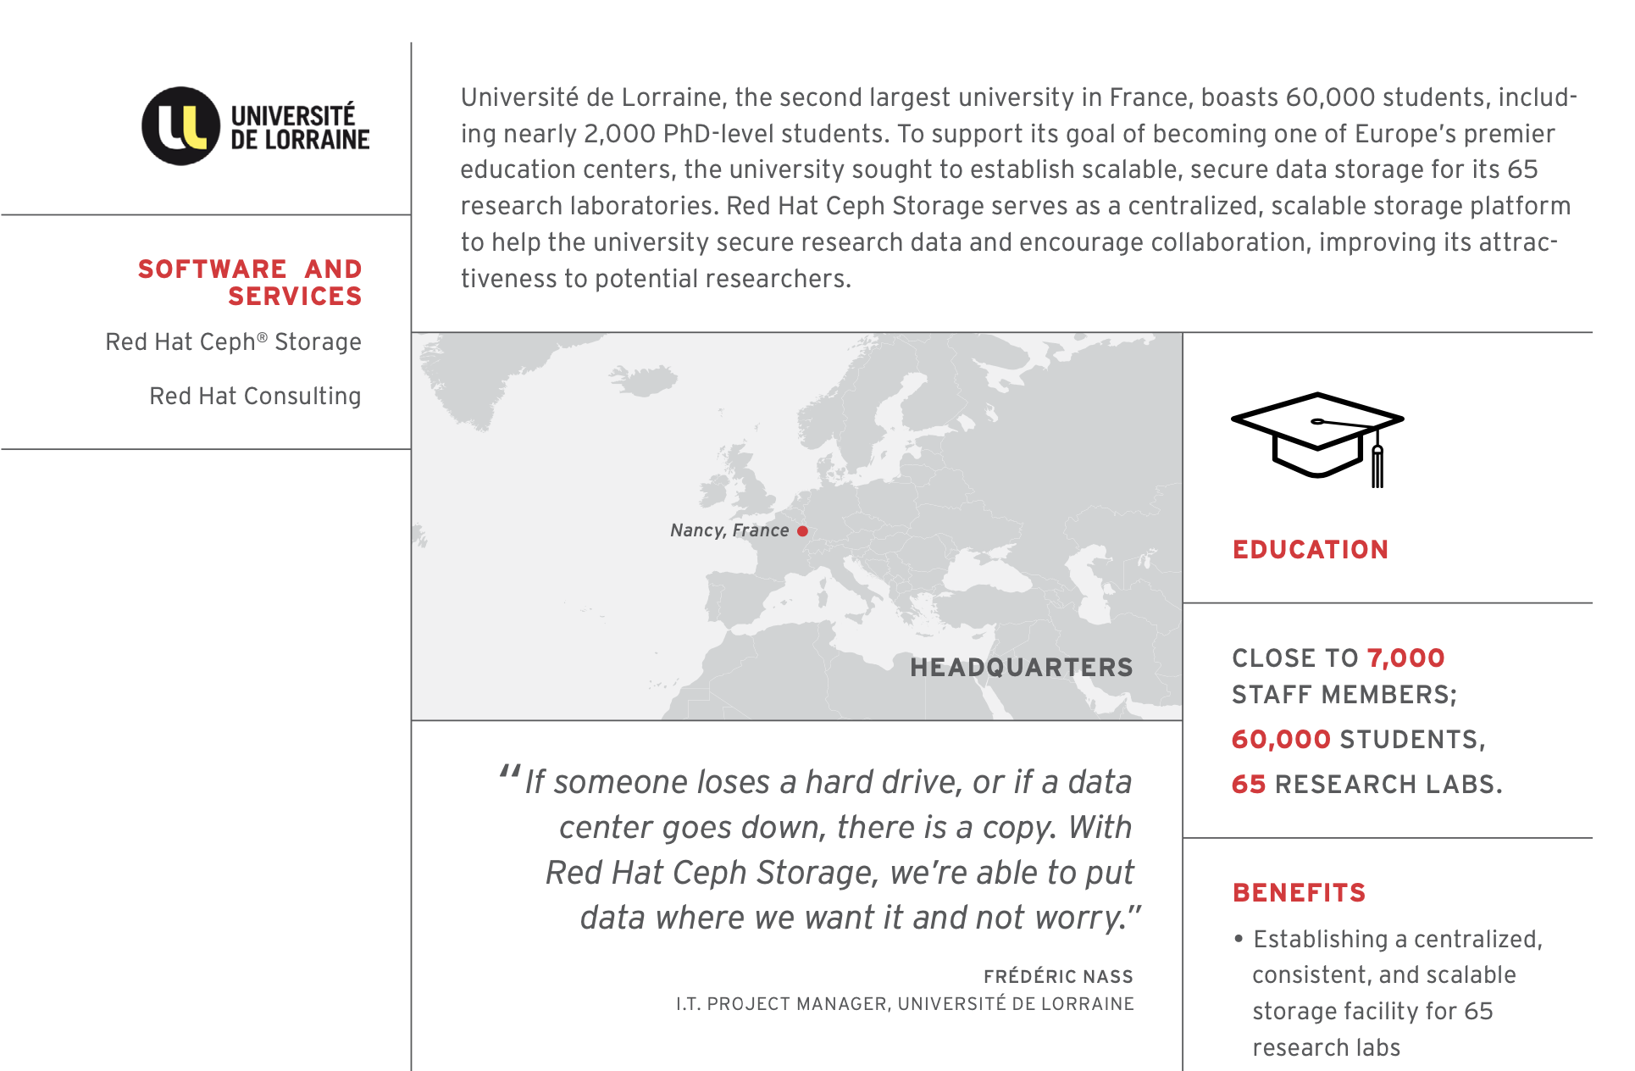
Quelques références universitaires...
=

Slide 41
Merci
05 Novembre 2020
Red Hat is the world’s leading provider of enterprise open source software solutions. Award-winning support, training, and consulting services make Red Hat a trusted adviser to the Fortune 500.

